Slide 1
CIS 600 LIBRARY ACCESS SYSTEM
Aishwarya Raghavan(213083215)
Karandeep Kaur( 564707615)
5/7/2013

Slide 2
PURPOSE
To make the library operations handy
Our app allows users to just scan the library code of the book and renew it with a click of button from their phone, so that you don’t have to go or call library just to tell them that you want to keep the book.
To renew the books using a mobile App , so that you don’t have to go or call library just to tell them that you want to keep the book.

Slide 3
Technologies Used
WAMP-( Windows, Apache, MySQL and PHP)
Storage of Central Database
Data Communication via PHP files.
GoogleAPI’s
Zxingjar-forScanning
Jsoup.jar- for parsing html pages
Mail.jar – for sending email to users

Slide 4
Login
Every user has to login to access the library resources through the Login screen. Depending on the Login type App will take you to the User or Admin screen.
Admin can return books by scanning or entering the data. On returning a book ,user gets conformation email.

Slide 5
Searching Books
User can search if book is available is library or not by
Scanning the ISBN
Typing in ISBN
Author Name
Book Title
Keywords

Slide 6
Account Details
Once User Login he can see
All the books he borrowed
Fines on his account
Due Date of the books
Different background of books past due

Slide 7
Express Renew
Scan the library code of the book to be renewed. It will bring up all the information of the book and fine, if there is any and you can renew it, if it doesn’t exceed the maximum number of renewals
Alternatively books can also be renewed from account details if phone camera doesnot works for some reason
User will get an email once book is renewed(or not)

Slide 8
Other Functionalities
View the book you have borrowed and when they are due
Know the fines you have on each book.
Search a book by scanning its ISBN and to know if your library has it.
Search for book in library by Author Name.
Search for book In Library by Title.
Search for book in Library matching a keyword.
Get reminders via email about the books borrowed and their due dates and fines you owe.

Slide 9
RESERVE
Reserve a book
- A user can search a book and can reserve it . Although in real scenario we can only reserve a book by going to library and checking it out. We made this functionality to demonstrate the renew functionality. So after searching for a book a user will be given an option to reserve the book if its available.

Slide 10
Admin Controls
Insert a books
Return books
Admin can scan the book library code and return it
He can enter the user id and library code of book to return it.

Slide 11
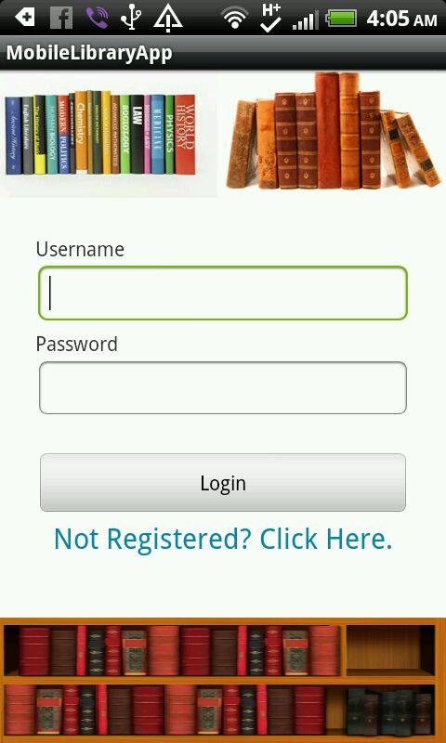
SCREEN SHOTS
Login

Slide 12
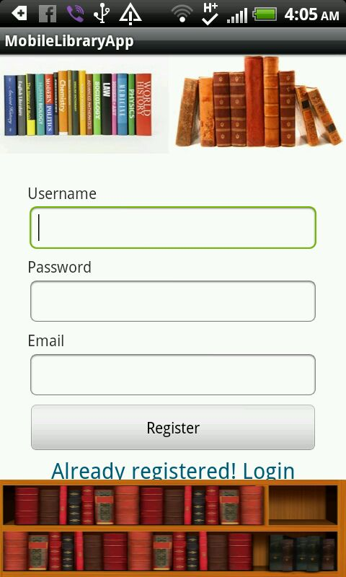
SCREEN SHOTS
Register

Slide 13
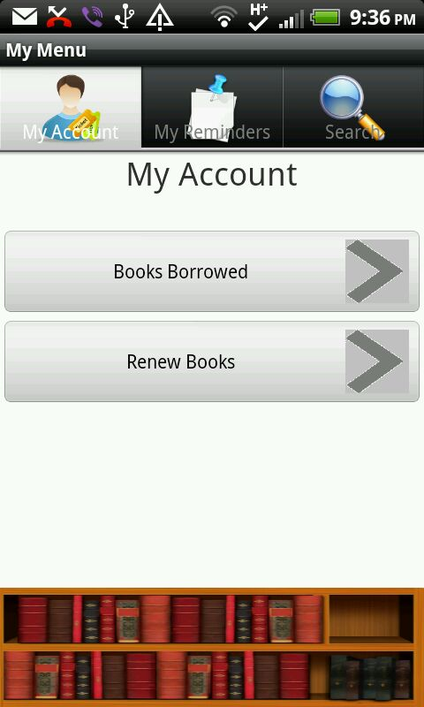
SCREEN SHOTS
User Account Tabs

Slide 14
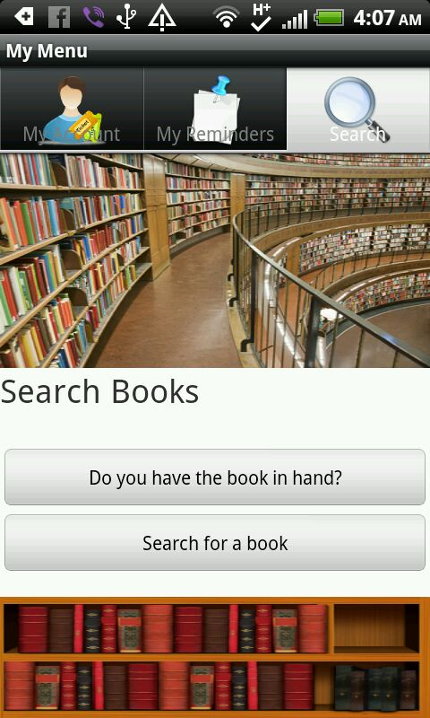
SCREEN SHOTS
Search Books

Slide 15
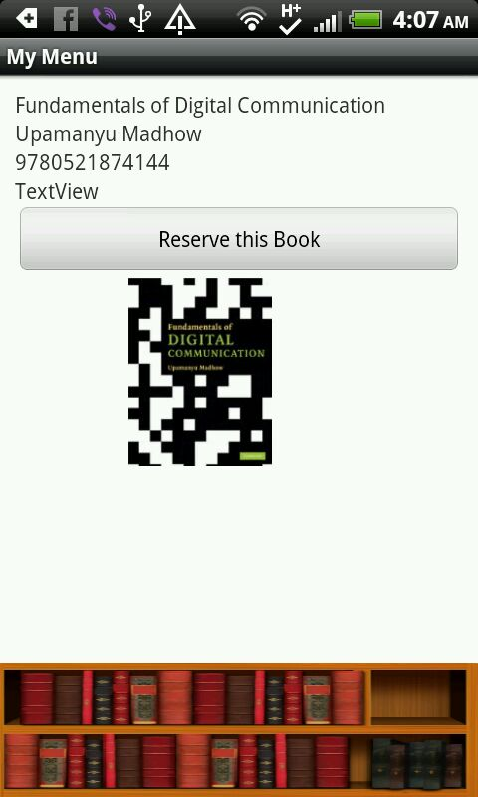
SCREEN SHOTS
Details View

Slide 16
Emails Sent
Validation

Slide 17
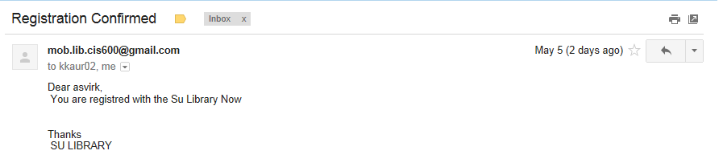
Emails Sent
Verification

Slide 18
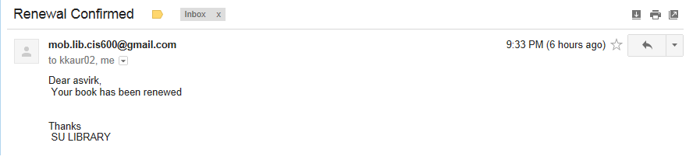
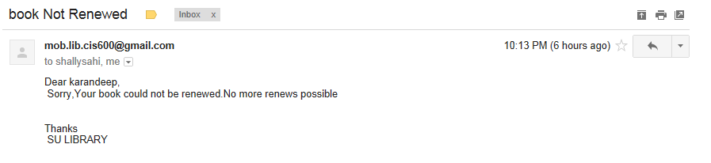
Emails Sent
Book Renewed
Not Renewed

Slide 19
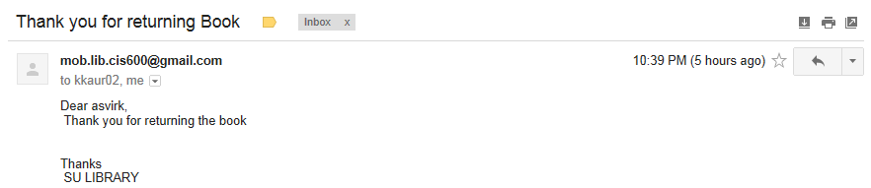
Emails Sent
Book Returned

